Slide 1


VIRTUAL INTELLIGENCE SERVICE
VICTORIA PER INTELLECTUM
INTELLIGENCE ESTIMATE
OPAR VIS INTREP XXX
DISCLAIMER:
This is for multiplayer online gaming using the Digital Combat Systems simulation software published by Eagle Dynamics. The information is not in any way suitable for real world use or operations.
Version: X.X
Published: YYYY-MM-DD

Slide 2
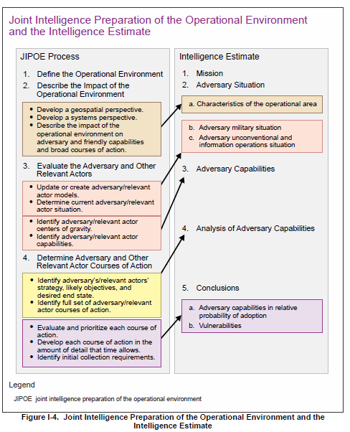
CHARACTERISTICS OF THE OPERATIONAL AREA

Slide 3
ENEMY MILITARY SITUATION

Slide 4
ENEMY CAPABILITIES

Slide 5
ANALYSIS OF ENEMY CAPABILITIES

Slide 6
CONCLUSION

